Slide 1
Consumer Sector Top 4
Consumer Staples
February 11rd 2016
Valay Shah
All Figures in $USD unless noted otherwise

Slide 2
Agenda
Current Holdings
Screening Criteria
Top 4 Consumer Staples Companies
Saputo Inc. (TSX:SAP)
North West Company Inc. (TSX:NWC)
USANA Health Sciences Inc. (NYSE:USNA)
Mead Johnson Nutrition Inc. (NYSE:MJN)
Questions

Slide 3
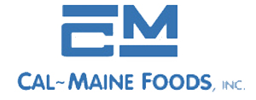

Current Holdings in Consumers
7.4% of portfolio in Consumers sector
Sanderson Farms Inc. (SAFM)
Cal-Maine Foods Inc. (CALM)
Consumer Staples
Agriculture Products
4.7% of holdings
Consumer Staples
Agriculture Products
2.7% of holdings
Source: Insider Knowledge
Appendix Map I
Notes:
We used to have 21% of portfolio in Consumers

Slide 4
Ranking Process
Higher Values
EBITDA Margin
3 YR Revenue CAGR
3 YR EBIT CAGR
EBITDA/Interest Expense
Net Income Margin
Return on Capital
Current Ratio
Lower Values
Debt/EBITDA
EV/Revenue
EV/UFCF
Price/BV
Price/Sales
EV/EBIT LTM
P/E Normalized
Appendix Map I
Notes:
Also, focused on companies with a Market Cap of less than $20B as they would be less covered and so it would provide for a better learning opportunity

Slide 5

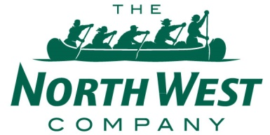
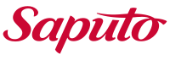
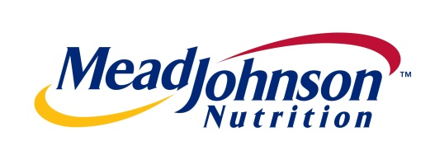
Top 4 Summary
Top 4 Summary
 | Saputo Inc. | USANA Health Sciences Inc. | North West Company Inc. | Mead Johnson Nutrition Inc.
Ticker | TSX: SAP | NYSE: USNA | TSX:NWC | NYSE: MJN
Industry | Dairy Products | Nutritional and Personal Care Products | Grocery Stores | Dietary Foods & Infants Foods
Share Price | $36.43 | $94.82 | $30.35 | $70.72
Market Cap. | $9,599 Million | $1,532 Million | $1,052 Million | $13,410 Million
Total Debt | $1,408 Million | $0 Million | $167 Million | $2,984 Million
Cash | $164 Million | $174 Million | $26 Million | $1,701 Million
EV | $10,831 Million | $1,358 Million | $1,183 Million | $14,732 Million
Credit Rating | BBB+ | N/A | A+ | BBB+
Source: S&P Capital IQ
Appendix Map I
Notes:
Saputo – Moody’s Rating = Baa1
Translated the credit ratings from moody’s to S&P

Slide 6
Saputo Inc.

Slide 7
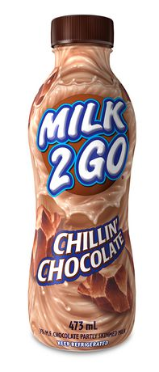
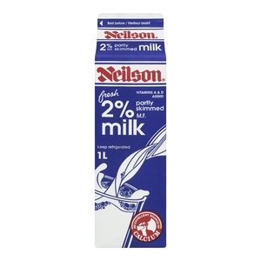
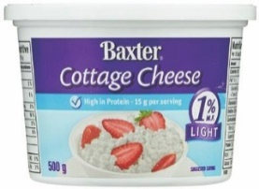
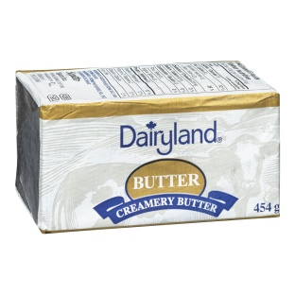
Saputo Inc. Overview
Saputo produces, markets, and distributes a variety of dairy items from cheese to milk
One of the top ten dairy processors in the world; largest cheese, milk, and cream processor in Canada
Product Mix
Financial Overview
Market Data
Share Price | $34.94
Market Cap | $9.6 B
Net Debt | $1.2 B
EV | $10.8 B
Dividend Yield | 1.6%
Beta (5 Year) | 0.51
LTM Income Profile
Revenue | $10.7 B
Gross Profit | $784 M
EBIT | $647 M
Net Income | $443 M
NI Margin | 5.6%
Diluted EPS | $1.1
Revenue Growth
CAGR = 14%
Multiples
EV/Revenue LTM | 1.4x
EV/Revenue NTM | 1.3x
EV/EBIT LTM | 17.6x
EV/EBIT NTM | 15.1x
P/E LTM | 23.8x
P/E NTM | 21.1x
MC/LFCF | 43.5x
Ratios
PEG NTM | 1.9
D / E | 47%
ROA | 7.9%
ROE | 16.9%
ROC | 9.9%
Source: S&P Capital IQ
Appendix Map I
Notes:
Also the 3rd largest dairy processor in argentina, 4th largest in australia, and top 3 in the usa for cheese products
High cash low debt
Highly regulated industry all across the world due to the nature of producing dairy products – high capex, & high transportation costs (daily transportation) so governments want to protect their local companies or else the lowest cost producer will easily win the battle – the high costs is why milk is known as WHITE GOLD – protect the dairy farmers because milk can only last at most a few days before expiration – also highly laborious process and employs a lot of people – lastly, the dairy industry needs strict regulations imposed upon it and customers trust homegrown products more than foreign ones because of the better regulations in the Canada and US
Diluted EPS is with including extraordinary items

Slide 8
Market Share for Saputo Inc. Among Competitors
Canadian
Cheese Industry
Canada & US
Milk Leaders ($33B)
Firgo Cheese Heads leads the string cheese head brand category in the U.S
Treasure Cave leads the crumbled blue cheese category in the U.S
Saputo has a 36% Market Share in the Fluid Milk and Cream Industry in Canada (Market Leader)
Source: 10K and CIQ
Appendix Map I
Notes:
*All Market Share values are by Revenues
*Nestle and General Mills etc are excluded because they deal with dairy products, I only used pure plays in the milk sector
Cheese is staple product in Canadian. Over recent years, there were a few notable trends in cheese consumption. First, Canadians, particularly the younger generation, are increasingly interested in a wider range of flavours, and are adventurous enough to experiment. As a result, new flavours, such as jalapeno, were becoming very popular in 2014 and into 2015, and cheese from smaller brands and manufacturers, particularly speciality cheese, received a boost in sales. Second, snacking is growing, whereby food consumption outside of meals is giving rise to big winners such as chips/crisps and snack bars, and cheese is one of the top snacking choices. Growing health-consciousness amongst Canadian consumers further lends a hand to cheese relative to other snacking options. As a result, cheese declined by 1% in volume terms but increased by 2% in current value terms in 2015,
Overall in Canada, sales of cheese are relatively consolidated. Saputo led in 2015, accounting for over a quarter (28%) of retail value sales of cheese in Canada, closely followed by Kraft Canada with a 22% value share, Agropur Cooperative with 21% and Parmalat Canada with 15%. Altogether, these four participants and their brands accounted for an 86% share of retail value sales of cheese, whilst no other player held a share of over 2% in cheese in 2015.
After a challenging year in 2014, drinking milk products, including flavoured milk drinks and milk (both dairy-based milk and non-dairy milk alternatives), declined by 2% in retail current value terms, to reach CAD3.7 billion in 2015. In particular, fresh milk, the largest category in drinking milk products, saw a decline of 2% in retail volume terms and 3% in current value terms. A number of factors contributed to this downturn. First, as a staple product in Canadians’ grocery basket, household penetration is already very high. Second, the ageing of the population overall (4% increase in the population aged 65+, compared with 1% growth in the general population) limited growth, as the older demographic typically drinks less milk. Third, the current regulatory framework makes innovation difficult, as the formulation and even packaging (for instance size) is under tight regulation. Fourth, alternative beverages to milk saw significant growth in recent years, including non-dairy milk alternatives such as almond milk. In fact, trade sources have mentioned that interesting flavours and portability are amongst the reasons the younger generation is shying away from milk.
Sales of drinking milk products in Canada are highly consolidated. Similar to previous years, Saputo, Agropur Cooperative and Parmalat Canada remained the top three players in drinking milk products, with a combined value share of 88% in 2015, and their dominance in milk is further strengthening due to mergers and acquisitions; hence leading them to hold an even greater share. Smaller players and brands are losing share and exiting the market, or becoming laser-focused on niche segments. For example, President’s Choice from Loblaw Cos continues to thrive in organic milk.
Other dairy is relatively fragmented, and the top three players, Saputo, Agropur Cooperative and Parmalat Canada (also the major players in drinking milk products) remained the leaders, with a combined value share of 52% in 2015, with no other players in this category having a share over 6%.
http://www.euromonitor.com/dairy-in-canada/report
The diary industry in Canada and us combined is $27 billion dollars by market cap

Slide 9
Saputo Inc. Performance
Revenue By Geography
Revenue By Sector
Stock Performance
Source: CIQ
Appendix Map I
Notes:
They sell products in over 40 countries
Retail – supermarket chains, convenience stores, mass merchandisers
Foodservice – to restaurants and hotels
Industrial – food processors using saputo products as ingredients
In June 15, the stock price dropped 7% due to Q4 earnings (quarter and year end are on March 31st for Saputo) not beating analyst expectations. Consensus was $0.4/share the actual was $0.32/share. They met and beat their q1 AND q2 EPS thus far however
Stock has recently shot up around 16% due to the EPS beating analyst expectations by 4 cents so the graph is not entirely up to date

Slide 10
Saputo Inc. Performance
Revenue By Geography
Revenue By Sector
Stock Performance
Source: CIQ
Appendix Map I
Notes:
They sell products in over 40 countries
Retail – supermarket chains, convenience stores, mass merchandisers
Foodservice – to restaurants and hotels
Industrial – food processors using saputo products as ingredients
In June 15, the stock price dropped 7% due to Q4 earnings (quarter and year end are on March 31st for Saputo) not beating analyst expectations. Consensus was $0.4/share the actual was $0.32/share. They met and beat their q1 AND q2 EPS thus far however

Slide 11
Saputo Inc. Comparison
Comparable Analysis
Company Name | Ticker | Mkt Cap | EV / Rev | EV / EBIT | P / Sales | P / B | P/E
Mondelez | NasdaqGS:MDLZ | 68,493 | 2.7 | 21.6 | 2.3 | 2.3 | 22.6
The J. M. Smucker Company | NYSE:SJM | 15,357 | 3.0 | 19.8 | 2.1 | 2.1 | 21.0
Dean Foods Company | NYSE:DF | 1,825 | 0.3 | 13.8 | 0.2 | 3.4 | 16.1
Lifeway Foods Inc. | NasdaqGM:LWAY | 209 | 1.8 | 61.4 | 1.8 | 4.5 | 39.4
Parmalat | BIT:PLT | 4,808 | 0.7 | 14.8 | 0.7 | 1.4 | 21.1
 | Mean |  | 1.7x | 26.3x | 1.4x | 2.8x | 24.0
 | Median |  | 1.8x | 19.8x | 1.8x | 2.3x | 21.1
Saputo | TSX:SAP | 9,599 | 1.4x | 17.6x | 1.3x | 3.5x | 21.1
Undervalued/(Overvalued) - Median |  |  | (19%) | (11%) | (28%) | (50%) | (0%)
Industry Comparison
CapitalIQ.com
Appendix Map I
Notes:
Add in Abbot Laboratories

Slide 12



Saputo Inc. Investment Outlook
Investment Strengths
Investment Risks
Weaker CAD boosts sales
Lower beta than Consumer Staples (0.68 vs. 0.51) against the S&P 500
Dividend has been increased 11-13% annually
Low debt levels fuel acquisition attempts
Streamlining Business; sold Bakery Division
Recent increase in sales prices and volumes
New flavour innovations in U.S were successful
Worldwide CF serve as natural hedge against currency fluctuations
Missed EPS estimates from Q2 2014-Q2 2015
Commodity nature of products it produces – little organic growth within the industry
TPP and CETA could have an adverse impact on sales
Reduced imports for China (slashed in half in early 2015)
Intense competition in Canada
Higher ingredient costs
Management Team
CFO
Louis-Philippe Carrière, FCPA, FCA
Chairman of the Board
Lino Saputo
CEO and Vice Chairman of the Board
Lino Saputo Jr.
CapitalIQ.com
Appendix Map I
Notes:
Strengths:
Fluctuating Canadian dollar has a positive impact on U.S revenues and EBITDA but negative implications in the international sector
Acquired 88% of Warrnambool Cheese and Butter factor company holdings limited & acquired Lion Dairy and Drinks in 2015 in Australia
Dairy division in Montreal completed their consolidation of its warehousing activities
Bakery division was sold off in Canada (worth 3% of the Canadian sector’s revenues)
Minimized the effect of fluctuating cheese and dairy ingredients by improving upon operational efficiencies
Attracted new customers through flavour innovations to their cheese products
Two new production lines have begun operating in Argentina
Improving margins in Australia due to a higher quality product mix and improving efficiency in projects
Repurchased shares and issued greater dividends
Streamlined their business by disposing of the Bakery division on a debt-fee basis ($0.06 increase in EPS)
Growing world demand for protein is why they wanted to acquired Warrnambool in Australia to pierce the Asian-Pacific market; they believe that synergies will increase the margins of Warrnambool and they are targeting China as its domestic milk production is declining and its middle class is growing
The soaring popularity of pizza has catapulted Saputo in the last 10 years
Risks
Increased competition in Canada and higher ingredient costs along with inefficiency such as delays and delivering products which increased warehouse costs and logistic costs
Bad economic market as prices of cheese increased and put downward pressure on EBITDA for U.S and Canada
Management Team
Senior Saputo is the 6th richest man in Canada and 298th richest in the world with a net worth of over $4B
He was born to a master cheesemaker in Italy, immigrated here in 1952, and took over his father’s business in 1969, IPO in 1997
It’s a family owned business the son had a lot of hands on experience with the business when he was younger as he was the vice president of operations in 1993 at the age of 23 and became the CEO in 2004 at the age of 37
He’s seen Saputo through their expansion into U.S and now overseas. They have performed well under his tenure with sales in U.S being 50% of their total revenues
CFO started as a Supervisor of Accounting in 1985, eventually kept rising through the ranks and in 2015 became the CFO
Compensation for management looks fair as the four officers earn between $2-$3.2M
Joey Saputo of Jolina Capital (lumber company) owns 33% of the shares
Patricia Saputo owns 9% through her capital management fund
No insider activity since Nov. 20th

Slide 13
North West Company Inc.

Slide 14
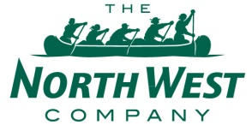
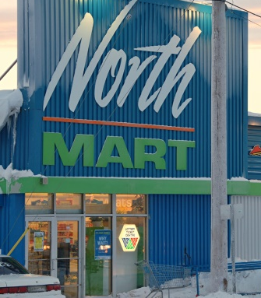


North West Company Inc. Overview
Founded in 1668, NWC used to compete with HBC before being merged with HBC
Today, it engages in the retail of food and general merchandise in rural communities and urban markets
Stores Mix
Financial Overview
Market Data
Share Price | $30.53
Market Cap | $1,051 M
Net Debt | $141 M
EV | $1,183 M
Dividend Yield | 4.6%
Beta (5 Year) | 0.24
LTM Income Profile
Revenue | $1,754 M
Gross Profit | $387 M
EBIT | $81 M
Net Income | $53 M
NI Margin | 3.9%
Diluted EPS | $1.1
Revenue Growth
CAGR = 0%
Multiples
EV/Revenue LTM | 0.9x
EV/Revenue NTM | 0.9x
EV/EBIT LTM | 15.7x
EV/EBITDA NTM | 9.9x
P/E LTM | 20.9x
P/E NTM | 18.7x
MC/LFCF | 22.9x
Ratios
PEG NTM | 0.0
D/E | 64%
ROA | 8.9%
ROE | 20.6%
ROC | 11.9%
Same Store Sales Growth | 2.4%
Source: S&P Capital IQ
Appendix Map I
Notes:
This company was the biggest rival to Hudson’s Bay until 1821 when it merged with HBC. It continued to operate as a norther stores division of HBC until that division was bought by investors in 1987 and it was re-launched as the North West Company
Same store sales growth has increased over the last three years from 0.5 to 1.2 to 2.4%

Slide 15
North West Company Market Share Among Comparables
Total Revenues =$50B
Total Market Cap =$42B
Appendix Map I
Notes:
This market share breakdown is by revenue dollars
Kmart is a big player too but unfortunately it is private (they purchased Sears holdings)
Alimentation Couche-Tard is Mac’s the convenience stores

Slide 16
North West Company Performance
Canadian Stores Breakdown
International Stores Breakdown
Stock Performance
(1) From Bloomberg
Appendix Map I
Notes:
Northern stores are loated in communities with populations ranging from 300 to 9000 and a typical store is around 7500 square feet
Products include food, family apparel, housewares, appliances, outdoor products, and they also have services such as pharmacies, income tax return preparation. Fuel, post offices, prepared food, ATMs, credit card program etc.
Canadian Stores Breadown
Northern Stores provide food, financial services, and general merchandise to northern communities
North Mart stores are targeted at larger northern markets as they have an expanded selection of fresh foods, fashion, and health products/services
Quick Stop are convenience stores
Giant Tigers are junior discount stores they are like a smaller walmart
Others comprise of 1 Price Chopper, a few other discount stores, and 2 fur trade stores (they still have those!)
International Stores
AC Value Stores are similar to North Mart and Northern stores as they give general merch to northern communities in Alaska
Quick Stop = convenience stores in Alaska
Cost U Loss = Carribbean and South Pacaific stores in island communities; giving them merch and discount food products

Slide 17
North West Company Comparison
Comparable Analysis
Company Name | Ticker | Mkt Cap | EV / Rev | EV / EBIT | P / Sales | P / B | P/E
Alimentation Couche-Tard | TSX:ATD.B | 24,663 | 0.9 | 18.6 | 0.8 | 5.7 | 20.2
Metro Inc. | TSX:MRU | 6,991 | 0.9 | 14.7 | 0.8 | 3.8 | 17.2
Village Super Market | NasdaqGS:VLGE.A | 371 | 0.2 | 8.2 | 0.2 | 1.5 | 0.0
PriceSmart Inc. | NasdaqGS:PSMT | 2,325 | 0.8 | 15.3 | 0.8 | 3.9 | 23.1
Dollarama | TSX:DOL | 6,649 | 3.9 | 19.6 | 3.8 | 15.2 | 24.1
 | Mean |  | 1.4x | 15.3x | 1.3x | 6.0x | 16.9x
 | Median |  | 0.9x | 15.3x | 0.8x | 3.9x | 20.2x
North West Company | TSX:NWC | 1,052 | 0.9x | 15.7x | 0.8x | 4.3x | 18.7x
Over / Undervalued (Compared to Median) |  |  | 11% | 3% | 5% | 12% | (8%)
Industry Comparison
CapitalIQ.com
Appendix Map I
Notes:
Only 572 employees
Growth is fuelled by market share expansion within existing locations, and opening wholesaling and independent stores

Slide 18



North West Company Investment Outlook
Investment Strengths
Investment Risks
Market domination in the remote areas it operates in
Operating stores in difficult-to-reach markets where few competitors lie
Ability to adapt to unique local lifestyles and cultures to capture selling opportunities
Heavily involved and trusted by the local communities
Low oil prices benefit transportation and energy costs such as diesel-generated electricity
Weak dollar boosts international operations
Low growth potential if it remains in secluded areas
Increase in food prices transfers over to customers
Hard to attract and retain talent within the company due to remote locations
Low oil prices could disrupt their Alaskan operations
Majority of customer’s income tied directly or indirectly to governmental expenditure (social assistance, infrastructure spending etc.)
Susceptible to food-borne illnesses (78% of sales are food sales)
Company’s operations are exposed to harsh climate
Management Team
Chief Merchandising Officer and Executive VP
Christine Frazier-Coleman
CEO and President
Edward S. Kennedy
CFO and Executive VP
John D. King
CapitalIQ.com
Appendix Map I
Notes:
Investment Strengths
$12 for 3 L of milk in 2007
Market domination in remote areas as they are the only grocery store around. They focus on towns with population between 300 to 9000 people so in many of these communities, they have a monopoly
Because of the more intimate nature of the relationship between the customer and the retail store, they listen to their customers more and adapt to their lifestyle and their product needs as much as possible. An example of this is when they rehashed 30% of their inventory and sold it at a clearance and wrote down the rest in order to buy new inventory that would have more growth opportunity and be popular among it’s customers
They take many community initiatives and are heavily involved within their communities as they often meet with regional leaders to discuss the plans of the store and the community going forward
Threat of new competitors entering is low because most of these communities can only support one merchandise store
Investment Risks:
Growth potential is limited if the company only caters to these secluded areas
Transportation costs and
Some communities are propped up by the oil industries so if oil prices continue to be depressed these areas may over time become ghost towns
Most customers rely on governmental assistance for their financial needs and so a decrease in governmental income could impact north west’s ability to make large profits off of these customers; infrastructure spending means things like education jobs, construction jobs, sewage and repair jobs etc. policy changes and changes in government should also be monitored
Some of their international operations in the Caribbean are more susceptible to hurricanes, tsunamis, and earthquakes which could disrupt operations in major ways
Management Team
President Kennedy – joined in 1989 and in 1997 he became CEO after being the COO in Alaska
Christine Coleman – she was the vice-president of procurement and marketing and began in January 2010. Before that she was in Arizona with a privately held grocery chain
John D. King – joined in 1994 after completing his CA and CMA and went from being a controller to being the director of finance and became CFO in 2010
Compensation: CEO made 2.2M USD; next highest was COO at 900K USD
Very minor insider trading
Lots of asset management companies have a stake in NWC such as CIBC, BMO, Mackenzie, Franklin

Slide 19
USANA Health Sciences Inc.

Slide 20
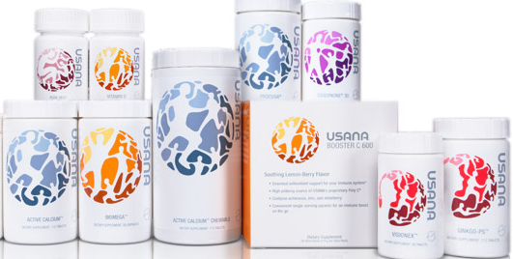
USANA Health Sciences Inc. Overview
Founded in 1992, USNA develops, manufactures, and sells science-based nutritional and personal care products to reduce the risk of chronic degenerative disease worldwide
The company distributes and sells its products through a network marketing system (direct selling)
Product Mix
Financial Overview
Market Data
Share Price | $120.00
Market Cap | $1,532 M
Net Debt | $(174) M
EV | $1,352 M
Dividend Yield | 0%
Beta (5 Year) | 1.14
LTM Income Profile
Revenue | $914 M
Gross Profit | $757 M
EBIT | $139M
Net Income | $92 M
NI Margin | 10.1%
Diluted EPS | $7.0
Revenue Growth
CAGR = 9%
Multiples
EV/Revenue LTM | 1.5x
EV/Revenue NTM | 1.4x
EV/EBIT LTM | 9.8x
EV/EBIT NTM | 8.5x
P/E LTM | 17.1x
P/E NTM | 14.4x
MC/LFCF | 18.8x
Ratios
PEG NTM | 1.2
D/E | 0%
ROA | 23.0%
ROE | 35.9%
ROC | 33.3%
Source: S&P Capital IQ
Appendix Map I

Slide 21
USANA Market Share Among Comparables
Total Revenues =$9.1B
Total Market Cap =$8.7B
Appendix Map I
Notes:
Herbalife was shorted a billion dollars by Bill Ackman in December 2012 because he accused it of being a pyramid scheme
Federal Judge dismissed a lawsuit which claimed that Herbalife was a pyramid scheme by defrauding shareholders and concealing the company’s revenues to it’s retail customers
USANA’s direct selling works the same as Herbalife’s so it is not considered a pyramid scheme but instead is considered a MLM

Slide 22
USANA Health Sciences Inc. Performance
Sales By Product Breakdown
Sales By Geography Breakdown
Stock Performance
(1) From Bloomberg
Appendix Map I
Notes:
Note about the stock performance, not completely up to date, stock has declined another 22% in the last couple of days

Slide 23
USANA Health Sciences Inc. Performance
Sales By Product Breakdown
Sales By Geography Breakdown
Stock Performance
(1) From Bloomberg
Appendix Map I

Slide 24
USANA Health Sciences Inc. Comparison
Comparable Analysis
Company Name | Ticker | Mkt Cap | EV / Rev | EV / EBIT | P / Sales | P / B | P/E
Nature's Sunshine Products Inc. | NasdaqCM:NATR | 141 | 0.3 | 8.2 | 0.4 | 1.1 | 15.0
Nu Skin Enterprises Inc. | NYSE:NUS | 1,930 | 0.8 | 6.8 | 0.9 | 2.3 | 14.0
Lifevantage Corporation | NasdaqCM:LFVN | 113 | 0.6 | 13.2 | 0.6 | 24.7 | 34.2
Herbalife Ltd. | NYSE:HLF | 4,165 | 1.1 | 8.3 | 0.8 | NM | 10.7
Synutra International Inc. | NasdaqGS:SYUT | 279 | 1.8 | 10.2 | 0.7 | 2.2 | 6.3
Natural Health Trends Corp. | NasdaqCM:NHTC | 256 | 0.6 | 3.2 | 1.0 | 4.5 | 5.5
Medifast Inc. | NYSE:MED | 328 | 1.0 | 7.7 | 1.2 | 3.8 | 18.5
 | Mean |  | 0.9x | 8.2x | 0.8x | 6.4x | 14.9x
 | Median |  | 0.8x | 8.2x | 0.8x | 3.0x | 14.0x
USANA Health Sciences Inc. | NYSE:USNA | 1,532 | 1.5x | 9.8x | 1.7x | 4.9x | 17.1x
Over / Undervalued (Compared to Median) |  |  | 82% | 19% | 102% | 64% | 22%
Industry Comparison
CapitalIQ.com
Appendix Map I
Notes:
From the industry comparison bar graphs, USANA is top 3 in each and every category among the 8 comparable companies
Large margins are helped by the fact that CAPX is only 0.7% of Revenue for the past three years
Herbalife’s P/BV has shot up to 151x because of recent lawsuits claiming the company is running an illegal pyramid scheme and bill ackman’s 1 billion dollar short against it so it’s price has suffered

Slide 25



USANA Health Sciences Inc. Investment Outlook
Investment Strengths
Investment Risks
High growth likely to continue as the company expands in foreign territories
Lean balance sheet with 0 debt, plentiful of cash, and high margins
Chinese deregulation of supplements; Self-regulation since 1994 in America
Weaker growth in the Americas and Europe is offset by strong growth in Asia Pacific
Low cost of staff and “Auto Order” sales increasing
High profile sponsorships, increasing brand recognition
USANA seems to be overvalued vs. competitors
Margins will be hurt if regulations are tightened
Products are overpriced versus competitors
Negative connotations of Multi-Level Marketing (MLM) structure
The company historically has suffered when competitors faced legal issues
Growth in the Americas and Europe is flat
Strong USD lowers profits
Missed EPS by $0.16/share, 22% drop in price
Management Team
Co-Chief CEO
Kevin Guest
Founder and Chairman of the Board
Myron Wentz
Co-Chief CEO
David Wentz
CapitalIQ.com
Appendix Map I
Notes:
Investment Strengths
Lots of demand in the Asian pacific will fuel growth there
Dietary supplements – vitamins and minerals only – can now bypass the CFDA (China’s FDA) registration process
44% of all sales are via Auto Order
Investment Risks:
A 2008 study found that a top selling USANA product, when taken in accordance with the company's recommendations, contains over 2,500% more lead than is legally allowed in the state of California under proposition 65. The study found that while USANA and Herbalife products contained toxic levels of lead, other manufacturers (with smaller profit margins) did not contain similar levels of lead. If USANA were forced to produce higher quality products (whichinvestigations have found they do not), margins would be tempered. Investors should be aware that the amazingly high margins are the product of poor self-regulation.
Lax Regulations – in 1994, under heavy lobbying from supplements industry, a law was passed which restricted FDA’s authority over supplements. Supplements today can pretty much claim whatever they want to as long as they do not claim to treat, cure, or prevent a disease.
Auto ship sales account for 44% of all revenues for USANA. FDA has launched a complaint against Vemma which is another company engaging in this practice so USANA could be on the hook for this as well
Potential pyramid scheme – USANA pays its associates to recruit new members and these associates can only be “commission qualified” if they purchase the required products themselves 81% of their customers are associates themselves so the vast majority of their sales comes from their own associates
Just missed their Q4 earnings; next year will likely see slower growth as investments in major IT platforms get underway in China
Management Team
Dr. Wentz launched Gull Laboratories as a one-man operation in 1974. By June of 1977, several of his viral diagnostic assays were FDA-approved and ready for marketing to hospitals and clinical laboratories. He developed the first commercially available test for diagnosing infection with the Epstein-Barr virus. Dr. Wentz sold his controlling interests in Gull Laboratories in 1992 and founded USANA Health Sciences, a state-of-the-art manufacturer of nutritional supplements, foods, and personal-care products.
As USANA's co-chief executive officer, Dave Wentz directs and maintains the vision and integrity of USANA as it continues to grow. He manages all global operations, works closely with the board of directors, and oversees the corporate governance required of a publicly traded company.
As the co-chief executive officer of USANA, Kevin Guest leads worldwide field development and sales and works with the Board of Directors and Management Team to develop short-term and long-term goals for the future of the company. He has worked closely with Dr. Myron Wentz—founder of USANA—for more than 23 years, and makes it his main job to maintain Dr. Wentz’ overall vision and direction for USANA. Prior to joining USANA, Kevin ran his own media production company, FMG Productions (which was acquired by USANA in 2004). This entrepreneurial experience gives him a unique perspective, which helps him better understand and relate to USANA and its Associates.
Compensation of management was between $1M-$2M USD; president of asia and greater china made more than the CEO
Both Wentz father and son sold 10,000 shares of USANA in December and January and Myron sold 113,000 shares in the LTM. Son has been selling shares every month since March 2014
50% ownership is by Dr. Wentz (Myron Wentz)

Slide 26
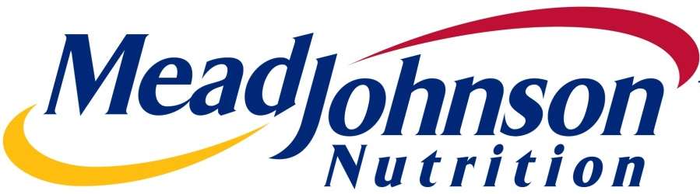
Mead Johnson Nutrition Company

Slide 27
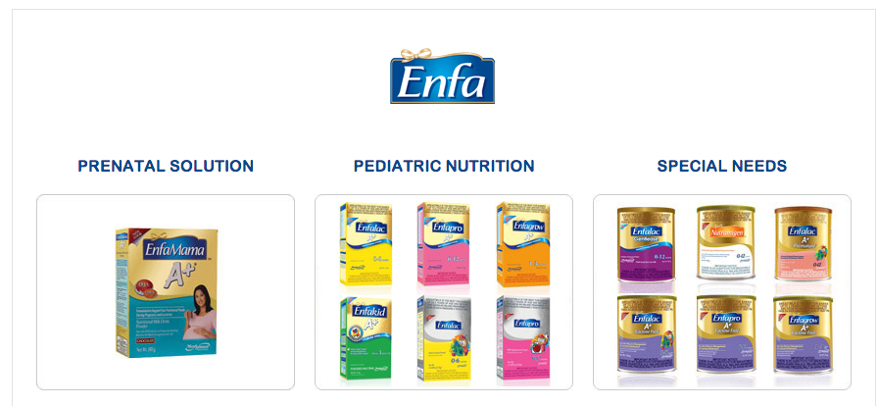
Mead Johnson Nutrition Overview
With over 100 years of experience, Mead Johnson Nutrition Company manufactures, distributes, and sells infant formulas, children’s nutrition, and other nutritional products
Also provides specialty formula products for addressing various conditions or special medical needs
Product Mix
Financial Overview
Market Data
Share Price | $71.94
Market Cap | $13,410 M
Net Debt | $1,322 M
EV | $14,732 M
Dividend Yield | 2.3%
Beta (5 Year) | 1.02
LTM Income Profile
Revenue | $4,071 M
Gross Profit | $2,616 M
EBIT | $936M
Net Income | $654M
NI Margin | 16.0%
Diluted EPS | $3.3
Revenue Growth
CAGR = 2%
Multiples
EV/Revenue LTM | 3.6x
EV/Revenue NTM | 3.8x
EV/EBIT LTM | 15.7x
EV/EBIT NTM | 15.5x
P/E LTM | 22.0x
P/E NTM | 20.5x
MC/LFCF | 18.2x
Ratios
PEG NTM | 2.3
D/E | NM
ROA | 15.1%
ROE | NM
ROC | 25.7%
Source: S&P Capital IQ
Appendix Map I
Notes:
ROE>ROA because the assets of the company are worth less than the equity
ROE & D/E are not meaningful (NM) because the equity is negative due to liabilities being greater than assets

Slide 28
Mead Johnson Market Share Among Comparables
Total Revenues =$164B
Total Market Cap =$371B
Appendix Map I

Slide 29
Mead Johnson Nutrition Performance
Sales By Product Breakdown
Sales By Geography Breakdown
Stock Performance
(1) From Bloomberg
Appendix Map I
Notes:
Other products consists of vitamins and supps
Infant formula includes specialty and solutions products which are for infants with extra nutritional needs
Market sell off caused the downward trend to start 2015 as it’s beta recently has been 1.44 against the market

Slide 30
Mead Johnson Nutrition Performance
Sales By Product Breakdown
Sales By Geography Breakdown
Stock Performance
(1) From Bloomberg
Appendix Map I

Slide 31
Mead Johnson Nutrition Company Comparison
Comparable Analysis
Company Name | Ticker | Mkt Cap | EV / Rev | EV / EBIT | P / Sales | P / B | P/E
The Hain Celestial Group, Inc. | NasdaqGS:HAIN | 3,514 | 1.5 | 14.3 | 1.3 | 1.9 | 18.5
Mondelez International, Inc. | NasdaqGS:MDLZ | 57,750 | 2.4 | 17.8 | 2.0 | 1.9 | 8.2
Nestlé S.A. | SWX:NESN | 235,564 | 2.7 | 11.1 | 2.5 | 3.7 | 15.9
Danone | ENXTPA:BN | 41,310 | 2.0 | 15.7 | 1.6 | 2.8 | 38.7
Perrigo Company Public Limited Company | NYSE:PRGO | 20,177 | 5.0 | 29.8 | 3.9 | 1.9 | 136.0
 | Mean |  | 2.7x | 17.7x | 2.3x | 2.5x | 43.5x
 | Median |  | 2.4x | 15.7x | 2.0x | 1.9x | 18.5x
Mead Johnson Nutrition Company | NYSE:MJN | 12,716 | 3.4x | 15.0x | 3.3x | 3.2x | 20.9x
Over / Undervalued (Compared to Median) |  |  | 42% | (5%) | 68% | 64% | 13%
Industry Comparison
CapitalIQ.com
Appendix Map I
Notes:
Add in Abbot Laboratories

Slide 32



Mead Johnson Nutrition Investment Outlook
Investment Strengths
Investment Risks
China’s two child policy being lifted will help the industry generate greater sales
Suppressed dairy prices increase gross margins
Distrust in local Chinese infant products has lead to a 10 fold increase in demand for imports
Company is committed to enhancing SHV: Large reserve of LFCF is utilized to borrow money to repurchase shares
A fully imported, premium brand in being launched in China later on this year
One of the few pure players in a niche industry dominated by mammoth companies
Stronger USD is detrimental to revenues
The industry is very dependent on consumer confidence of their product
MJN needs to expand it’s e-commerce and baby store distributorship efforts due to the shifting consumer trends in China
MJN’s locally produced baby formula products in China are hurting it’s organic sales growth
Management Team
COO and Executive VP
Charles M. Urbain
CEO and President
Kasper Jakobsen
CFO and Executive VP
Michel Cup
CapitalIQ.com
Appendix Map I
Notes:
Investment Strengths
52% increase in EBIT in the North American and European segment due to lower costs of input (deflated dairy prices)
Investment Risks:
Management Team
CEO made $8.2M last year and $5M of this was through stock options so there may be an incentive to repo shares; not much insider trading recently however
Blackrock owns 7.25%

Slide 33

Q&A

Slide 34
Appendix Map I
Saputo Inc.
North West Company
Presentation Slides
TPP Agreement
Presentation Slides
KPIs, Selected Annual Statements
Other Saputo Metrics
Hedges
Other Metrics
Giant Tiger Franchisee Agreement
Historical EV/EBITDA
Milk Prices
Historical EV/EBITDA
Historial P/E
Historical DPS and Dividend Yield
Historical P/E
Seasonality Effect
Saputo Financials
Store Locations
M&A Market Reaction
Hedges
M&A Activity
Management Initiatives
Forward Guidance
Historical DPS and Dividend Yield
Factors Affecting Saputo
Non-Company Specific
Current Holdings
Screens
Top 4 Summary
Correlation Matrix
Short Interest
CAD/USD Forex Impact
YUAN/USD Forex Impact
EPS Estimates vs. Actual

Slide 35
Appendix Map II
USANA Health Sciences Inc.
Mead Johnson Nutrition Company
Recruiting Process
Presentation Slides
Inventory Levels
Presentation Slides
YoY Sales
Hedges
Background Information
Direct Selling Model
Sales By Product and CFS
Manufacturing Facility Locations
Product Mix Breakdown
Associates and Court Case
Repurchasing Plan
Chinese Milk Scandal
U.S Regulations
USANA Product Potency
Sales By Region
Repurchase Plan's Effect
DPS and Dividend Yield
Sponsorships and Brand Awareness
Global Supplements Market
USANA Correlation with Competitors
Aging Populations
China and India's Disposable Income
Market Projections

Slide 36
Correlation Matrix with Current Consumers Holdings
Appendix Map I

Slide 37
Short Interest
Note: As a % of share price
Appendix Map I

Slide 38
Saputo Other Metrics
Diluted EPS
Levered Free Cash Flow
CAGR = 4%
CAGR = 7%
EBIT/Interest Expense
Net Income Margin
Appendix Map I

Slide 39
North West Company Other Metrics
Diluted EPS
Levered Free Cash Flow
CAGR = -2%
CAGR = -4%
EBIT/Interest Expense
Net Income Margin
Appendix Map I

Slide 40
USANA Health Sciences Other Metrics
Diluted EPS
Levered Free Cash Flow
CAGR = 8%
CAGR = 14%
Current Ratio
Net Income Margin
Appendix Map I

Slide 41
Mead Johnson Nutrition Other Metrics
Diluted EPS
Levered Free Cash Flow
CAGR = 6%
CAGR = 6%
EBIT/Interest Expense
Net Income Margin
Appendix Map I

Slide 42
Saputo Historical EV/EBITDA
EV/EBITDA
Appendix Map I
Notes:
Include Median/mean ev/ebitda and p/e also
This can be done by going into CIQ competitors

Slide 43
Saputo Historical P/E
P/E
Appendix Map I
Notes:
Include Median/mean ev/ebitda and p/e also
This can be done by going into CIQ competitors

Slide 44
North West Company Historical EV/EBITDA
EV/EBITDA
Appendix Map I

Slide 45
North West Company P/E
P/E
Appendix Map I

Slide 46
USANA Health Sciences Historical EV/EBITDA
EV/EBITDA
Appendix Map II

Slide 47
USANA Health Sciences Historical P/E
P/E
Appendix Map II

Slide 48
Mead Johnson Nutrition Historical EV/EBITDA
EV/EBITDA
Appendix Map II

Slide 49
Mead Johnson Nutrition Historical P/E
P/E
Appendix Map II
Notes:
The large drop off in P/E is attributable to Mondelez’s P/E dropping off due to their Q3 Earnings being stronger than expected
Only 14 constituents in the food products subsector

Slide 50
CAD/USD Forex Impact on Top 4
Correlation
-30%
-32%
-5%
-26%
Appendix Map I

Slide 51
YUAN/USD Forex Impact on Top 4
Correlation
-2%
1%
4%
-12%
Appendix Map I

Slide 52
EPS Estimates vs. Actuals
Saputo Inc.
North West Company Inc.
USANA Health Sciences Inc.
Mead Johnson Nutrition Company
Appendix Map I

Slide 53
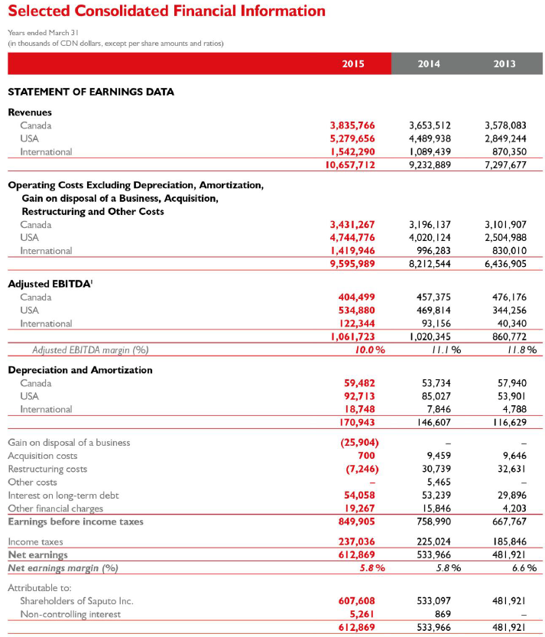
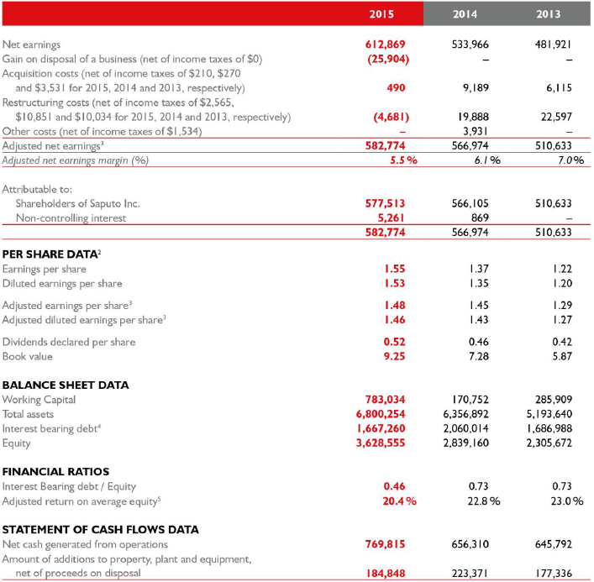
Saputo Financials

Slide 54
Recent Saputo M&As and Divestitures
Date | Target | Size ($USD) | Description
Oct 5, 2015 | Woolwich Dairy | $61M - Cash | Canadian Goat Dairy Products
May 25, 2015 | Lion-Dairy & Drinks (Owned 10% of Warrnambool’s shares and refused to sell) | $107M – Financed through bank loans | Australian Dairy and Juice Producer
Feb 2, 2015 | Saputo (Bakery Division sold to Canada Bread Company) | $103M - Cash | Was the largest Canadian manufacturer of snack cakes (less than 2% of Saputo’s revenues)
April 14, 2014 | Scotsburn Co-operative Services | $56M – Credit Lines | Canadian company’s fluid milk division bought out
Feb 12, 2014 | Warrnambool Cheese and Butter Factory Company Holdings Limited | $482M - Cash | Australia’s oldest milk & cheese processor – Bidding war won by Saputo
Appendix Map I
Notes:
Woolwich - Montreal-based Saputo announced Monday it has paid $80 million for the family-owned cheesemaking company, including its three plants and distribution centre and is located just west of Orangeville; this is the first acquisition of goat dairy products that Saputo has undertaken
Lion-Dairy & Drinks – actually acquired by a subsidiary (Warrnambool) - The transaction will enable WCB to increase its presence in consumer branded everyday cheese products segment in Australia with strong market positions in this segment and is consistent with Saputo’s stated strategy to invest in WCB to accelerate its growth in Australia
Saputo selling Bakery Division - the divestiture allows them to focus on their priority of being a global dairy company. Saputo has tried unsuccessfully to expand their bakery division but that was a wash so now it is time to unload. Canada Bread Company is a subsidiary of Mexican company – Bimbo
Scotsburn Co-operative Services - Its operations consist of manufacturing, selling, marketing, distributing and merchandising of products such as fluid milk, cream, sour cream, ice cream mix and cottage cheese, mainly under the Scotsburn brand – Generates around $160 million in revenues from fluid milk alone
Warrnambool - The strong interest in Warrnambool – the smallest of the listed Australian dairy processors – reflects surging demand for dairy products in Asia. Saputo had been in talks abouts acquiring Warrnambool for the past decade.
Bega, an Australian producer also attempted a bid. Along with Murray Goulbourn. Both australian. Bidding war ensued and Saputo won at at $9.40 cash per share (KPMG valued Warrnambool at $7-$7.50/share) but the deciding factor was that they vowed to keep management intact so they can keep competitive in the milk segment in Australia. Right before the bids, Its net profit for the year to last June had plunged to $7.5 million, down more than 50 per cent on the previous year on the back of soft international milk prices, a high Australian dollar and strong competition.
The Australian production has declined 1.7 per cent in the past decade as it battled drought, deregulation and declining property values. Saputo CEO talked about capitalising on the Asian 'dining boom', increasing milk production, and growing farmers' wealth.
Low AUS/USD also helps Saputo here
Only way to grow in this market is to steal volume from your competitor and make acquisitions
Low, single digit, accretion to Saputo’s trailing EPS
Saputo focuses mostly on growth by acquisition; they have a solid track record of selecting acquisition targets as historically they’ve done well with them
Analysts see initial EPS accretion from the deal at 10 cents and could rise to 15 cents once Saputo improves production efficiences and product mix → could result in $4-$5 upside

Slide 55
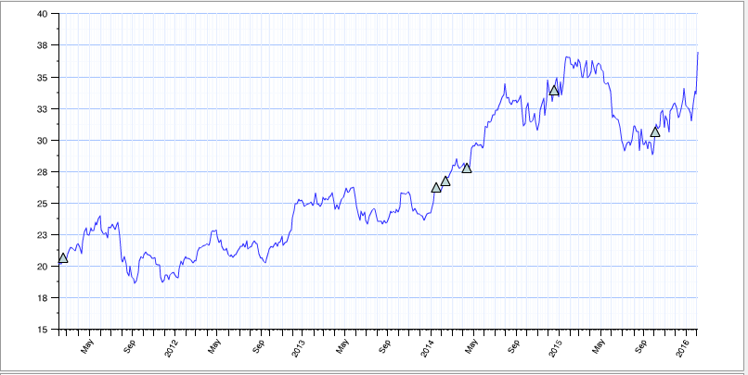
Saputo Market Reaction to Acquisitions Last 5 Years
Fairmont Food Acquisition
Scotsburn
Acquisition
Warrnambool Cheese
Acquisition
Bakery Division
Divestiture
Woolwich
Acquisition
Appendix Map I

Slide 56
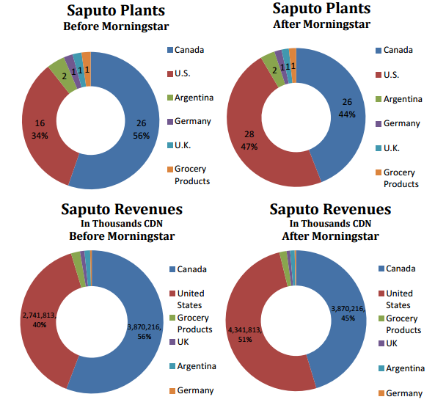
Saputo Plants
Morningstar was a subsidiary of Dean Foods
They have 25 distributor centers in Canada but only 1 distributor center in the U.S
U.S plants are cheese producers; other dairy products are still exported from Canada
Appendix Map I

Slide 57
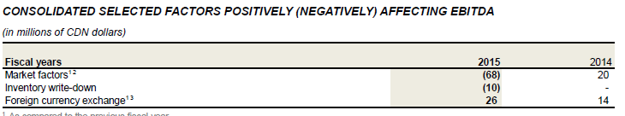
Factors Affecting Saputo - Overall
Revenues increase attributed to:
Higher block market per pound of cheese
High average butter market price
Weakening of CDN
Inclusion of revenues from Warrnanmbool acquisition
Increased selling prices in accordance with the cost of producing milk
Partially offset by:
Decrease in selling prices in the international market
Decrease in sales volume in the Dairy Division in Argentina
Unfavourable exchange rate in Argentina
Appendix Map I

Slide 58
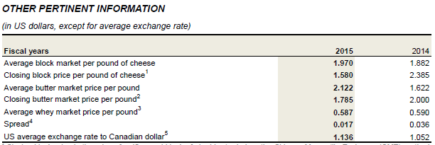
Factors Affecting Saputo - Overall
Over the course of the year, block price per pound of butter and per cheese fell sharply, lowering selling prices and hurting revenues
But comparing the average prices in FY15 to FY14, the average block price per pound of butter and cheese actually rose thus producing stronger revenue numbers than in 2014
Appendix Map I

Slide 59
Factors Affecting Saputo - Canada
Revenues in Canada increased 5% YoY mostly due to:
Increased sales volumes and higher selling prices relating to the increase in the cost of milk as raw material
Cheese, traditional milk and butter sales volumes were higher
Dairyland and Neilson, continue to be the #1 and #2 brands in the refrigerated dairy case on a national basis
EBITDA in Canada decreased 12% YoY mostly due to:
An increasingly competitive environment for diary producers in Canada (to be worsened slightly by the TPP agreement)
Increased warehousing, logistical, administration, production and ingredient costs
Delay in execution and completion of certain projects during the year decreased EBITDA.
Also, efficiencies did not materialize as planned, resulting in additional warehousing and logistical costs
Increased administration expenses related to an analysis on a new Enterprise Resource Planning (ERP) system
The Scotsburn Acquisition has generated a lower EBITDA than expected.
The disposal of the Bakery Division in the fourth quarter also reduced EBITDA
Appendix Map I

Slide 60
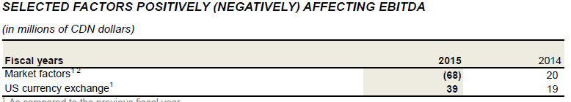
Factors Affecting Saputo – United States
Revenues in U.S increased 18% YoY mostly due to:
A higher average block market per pound of cheese of US$1.97 in fiscal 2015, in comparison to US$1.88 in fiscal 2014, as well as an average butter market price of US$2.12, as compared to US$1.62, increased revenues by approximately $261 million
CDN/US Forex impact = +362M
EBITDA in U.S increased 14% mostly due to:
Improved operational efficiencies, increased sales volumes
In 2015, the block price of cheese opened at US$2.39 and closed at US$1.58, a decrease of US$0.81, compared to opening at US$1.69 and closing at US$2.39, an increase of US$0.70, for the previous fiscal year. This net difference for fiscal 2015 had an unfavourable impact on the realization of inventories. However, the higher average block market positively affected the absorption of fixed costs
Appendix Map I

Slide 61
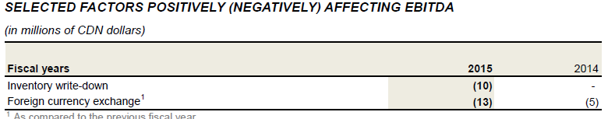
Factors Affecting Saputo – International Sector
Revenues in the International sector increased 42% YoY mostly due to:
This increase is mainly due to the inclusion of revenues from the Dairy Division (Australia) for the full year as compared to nine weeks in fiscal 2014
The Dairy Ingredients Division’s revenues were higher as compared to fiscal 2014 due to increased ingredient sales volumes and a favourable product mix
The fluctuation of the Canadian dollar versus the foreign currencies used in the International Sector negatively impacted revenues by approximately $90 million
EBITDA in International markets increased 35% mostly due to:
Contributing to this increase was the inclusion for the full year in fiscal 2015 of EBITDA from the Dairy Division (Australia), as compared to nine weeks in fiscal 2014
The strengthening of the Canadian dollar in fiscal 2015 eroded approximately $13 million of the International Sector EBITDA
Appendix Map I

Slide 62
Forward Guidance – Saputo Overall
Canada:
Dairy prices are expected to continue to remain low throughout 2016; depressed margins
Focus will shift to strengthening cost control
Acquisition of Scotsburn enables the Dairy Division to increase its presence out in the Atlantic region
ERP up-front cost = $210-250 million spread out over 5 years; annual after-tax savings expected of $20-$25 million
United States:
Lower margins expected due to low dairy prices
Focus will shift in 2016 to strengthening cost control; becoming a low-cost producer
Capture additional volumes in the Cheese Division
The Cheese Division plans to continue to gain distribution and market share for its premium lines of snack cheeses and flavoured blue cheese offerings.
International:
Low cheese and dairy prices will put downward pressure on margins
Focus on controlling costs and increasing efficiencies will mitigate their impact on EBITDA
Continue to pursue sales volume growth in existing markets, as well as develop additional international markets from its operations in Argentina for which capacity has been increased in the last few years
Utilize the newly added Dairy Division (Australia) to penetrate markets in the Asian-Pacific (China)
Appendix Map I

Slide 63
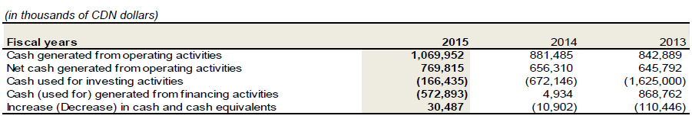
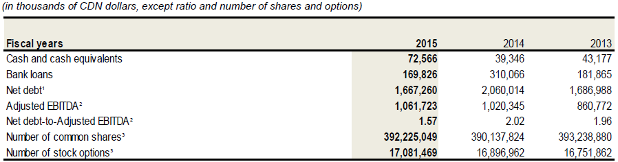
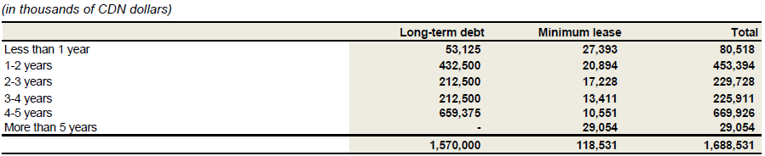
Ability to Meet Debt Obligations
Appendix Map I
Notes:
$250 M of financing activities were for dividends + share repurchases.

Slide 64
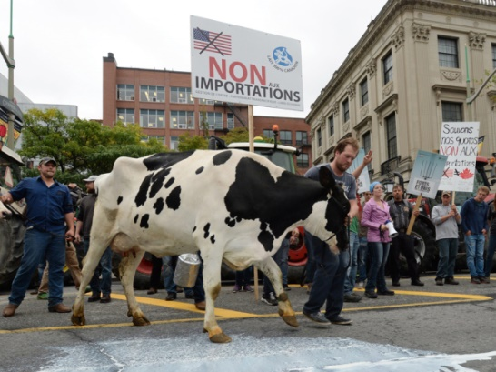


TPP Agreement Impact on Saputo
The TPP agreement gives Canada’s TPP partners access to 3.25% of Canada’s dairy production market
TPP partners initially wanted 10%
Canada’s supply management system of price control, production control, and import control will remain intact
85% of imports coming in still have to be processed at facilities in Canada; this shields domestic dairies from production volume drops which would have compromised their economies of scale
The government will provide a $4.3B compensation package over 15 years to minimize the effects on dairy, poultry, and egg industry
A study from Tufts University found TPP will cost Canada 58,000 jobs, increase GDP by 0.28%, and increase income inequality
2% access has already been ceded to the Europeans in 2013 for cheese products
Ratification of the deal is still two years away; Liberal Party’s position is uncertain
Appendix Map I
Notes:
Canada has to participate in the TPP because Japan is a major exporter for us and if we were at a tariff disadvantage to U.S and Japan, then it would be game over for Canadian exports

Slide 65
Hedging Activity
Due to its large and diverse customer base and its geographic diversity, the Company has low exposure to credit risk concentration with respect to customer’s receivables. There are no receivables from any individual customer that exceeded 10% of the total balance of receivables
The bank term loan bears interest at variable rates and thereby exposes the Company to interest rate risk on cash flows associated to interest payments. As a result of such interest rate risk, the Company entered into interest rate swap agreements on February 4, 2013 for the initial term of the bank term loan facility, ending in December 2016, in which the Company agreed to exchange variable interest payments for fixed rate payments at 1.58% plus applicable spread at specified intervals
Forex Risk: Every 1% weakening of the CAD against the USD leads to:
No foreign currency contracts in place
Forward exchange contracts in place to sell USD for AUS
Commodity Price Risk – futures contracts in place; unrealized gain of $854,000
Long term target for leverage = 2 times net debt to earnings
Appendix Map I
Notes:
Canada has to participate in the TPP because Japan is a major exporter for us and if we were at a tariff disadvantage to U.S and Japan, then it would be game over for Canadian exports

Slide 66
Milk Historical Prices
Appendix Map I
Notes:
Milk prices have tumbled due to overproduction, China’s inventories are full right now; more de-regulation will continue the supply glut
Chinese demands causes the most volatility. Milk prices were higher last year due to greater Chinese demand, but china puled back on its dairy imports after stockpiling milk powder which caused a glut of supply; good news for farmers is that feed pries are also low; saputo buys milk from dairy farmers so they get to buy the milk at a discount, but also have to sell at low prices
Milk demand is decreasing in the U.S due to consumer trends opting for more almond milk and fat free products
Consumer does not need reduced milk prices substantially because the middlemen take the higher margins
85% of Raw Material costs for Saputo are milk prices
Four Classes of Milk
Milk is priced depending on its use (class)Class I: Beverage Milk
Class II: Soft Manufactured Products (Yogurt, Cream, Cottage Cheese)
Class III: Hard Cheeses and Cream Cheese
Class IV: Dry Milk Products and Butter
http://future.aae.wisc.edu/tutor/class_pricing/overview.html
http://www.rotmanassetmanagement.com/wp-content/uploads/2013/08/RAMA_ERC_2012_3rd_Place.pdf

Slide 67
Historical DPS and Dividend Yield
Appendix Map I
Notes:
DPS has been increasing over time
Dividend yield is fluctuating between 1.5 to 2.5%

Slide 68
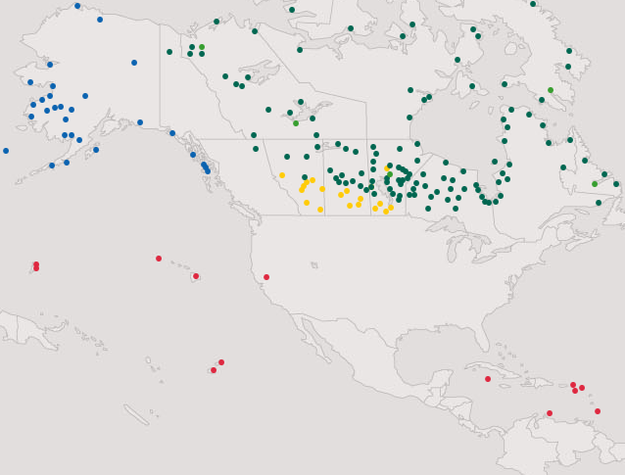
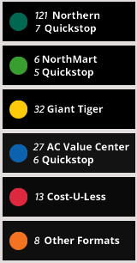
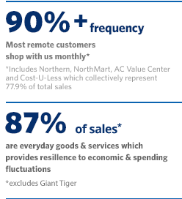
North West Company Store Locations
Appendix Map I
Notes:
Leading retailer in underserved rural communities and urban neighbourhoods such as Northern Canada, Western Canada, Rural Alaska, the South Pacific, and the Caribbean

Slide 69
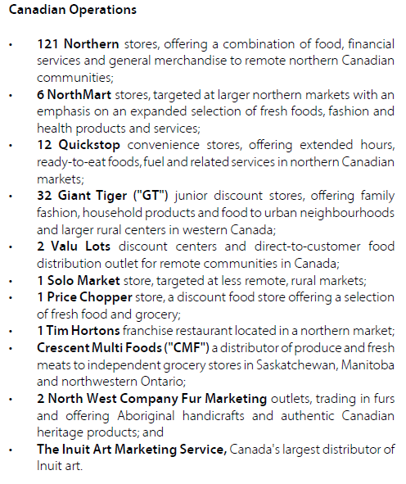
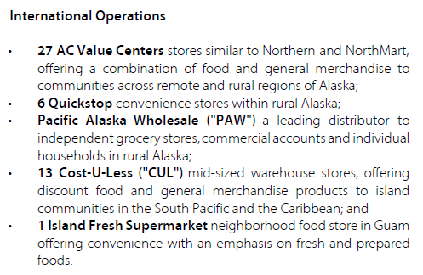
North West Company Stores
Appendix Map I

Slide 70
Management Initiatives
Top 40 Markets Expansion – 12 New stores are to be completed by early 2016 in Northern Canada. Main driver of growth.
Top Categories – Downsizing merchandise product categories to create space and capital for top categories. 30% of general merchandise was marked-down and the company incurred around $3.8 million in costs related to write-down and clearance of this inventory. Greater variety of products will be coming up in the food service, pharmacy, product, meat, baby, children, grocery, automobile, furniture, outdoor living departments.
Implement a Transportation Management System (TMS) to enable product visibility and tracking throughout the logistics network
Building onto the Relationship with Giant Tiger Stores Limited – Northwest is a franchisee of GTSL and opened three new GTSL stores in 2015
Close Performance Gaps in Cost-U-Less stores – Reduced the cost of goods and aligned products with customer preferences to be successful in the Caribbean
Customer Driven and Store Centric – A new store service named “Store Connect” was launched to track all customers and store issues, requests, and customer ideas to the final resolution.
Appendix Map I

Slide 71
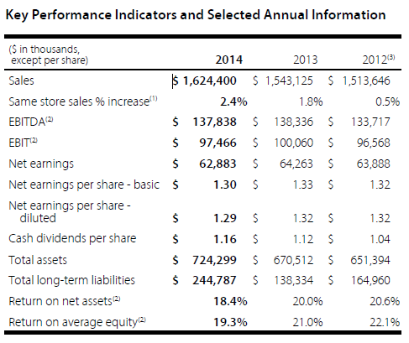
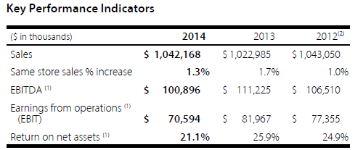
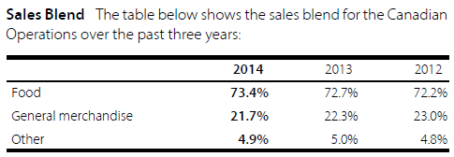
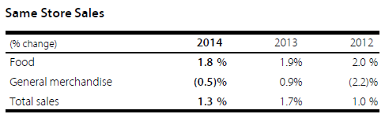
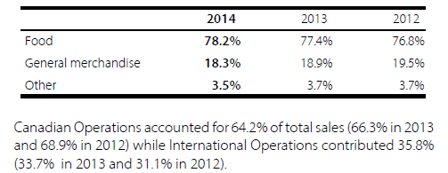
KPIs and Selected Annual Information
Canada Operations
Appendix Map I
Notes:
Same store sales for general merchandise will experience greater fluctuations because it depends on discretionary income whereas food store sales will be quite similar on a year to year basis since these are staples
Gross profit has decreased because of the company’s initiative to launch new products and clear out old ones which were cleared out at large discounts and many items were written down

Slide 72
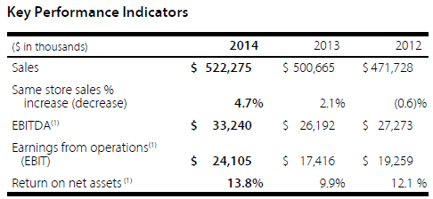
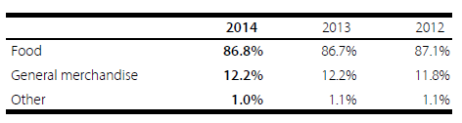
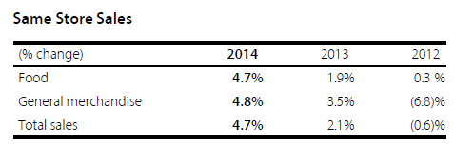
KPIs and Selected Annual Information
International Operations
New merchandise assortments, a better in-stock position, improved store execution, strong promotional selling activities and a modestly improved economic environment were leading factors contributing to the same store sales growth
Major store expansion in Alaska and investments in energy efficient refrigerators and equipment upgrades increased EBITDA
Appendix Map I

Slide 73
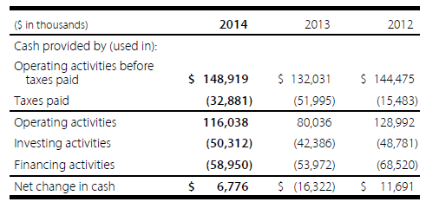
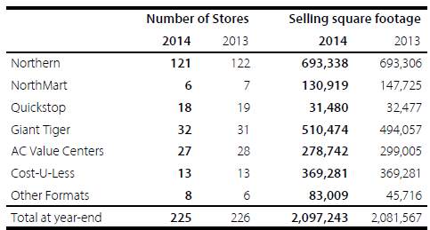
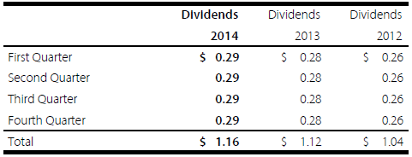
Liquidity and Cash Flows
Increase in taxes paid in 2013 due to the company switching to being a share corporation so they had to pay instalments
Cash flow from operating activities and unutilized credit available on existing loan facilities are expected to be sufficient to fund operating requirements, pension plan contributions, sustaining and planned growth-related capital expenditures as well as anticipated dividends
Appendix Map I

Slide 74
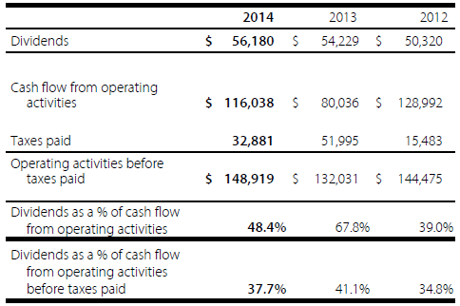
More Dividend Information
The decrease in dividends as a percentage of cash flow from operating activities to 48.4% compared to 67.8% in 2013 is largely due to the conversion to a share corporation and the timing of payment of Canadian income tax instalments
Appendix Map I

Slide 75
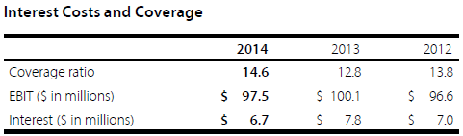
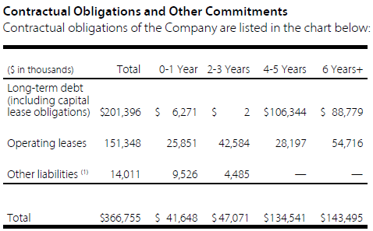
Liquidity and Interest Coverage
The Canadian Operations have available committed, extendible, revolving loan facilities of $200.0 million that mature on December 31, 2018
The Company's International Operations have available committed, revolving loan facilities of US$52.0 million that mature on December 31, 2018
Appendix Map I

Slide 76

Giant Tiger Master Franchise Agreement
In 2002, the Company signed a 30-year Master Franchise Agreement with Giant Tiger Stores
Limited which granted the Company the exclusive right to open Giant Tiger stores in western Canada. Under the agreement, Giant Tiger Stores Limited provides product sourcing, merchandising, systems and administration support to the Company's Giant Tiger stores in return for a royalty based on sales
The Company is responsible for opening, owning, operating and providing food buying and distribution services to the stores. As a result of the closure of six stores during 2012, the Company has fallen below the minimum number of stores required to maintain its exclusive right to open Giant Tiger stores in western Canada. The loss of exclusivity does not constitute an event of default under the Company's master franchise rights and will not prevent the Company from continuing to operate its existing stores or open new stores.
Appendix Map I

Slide 77
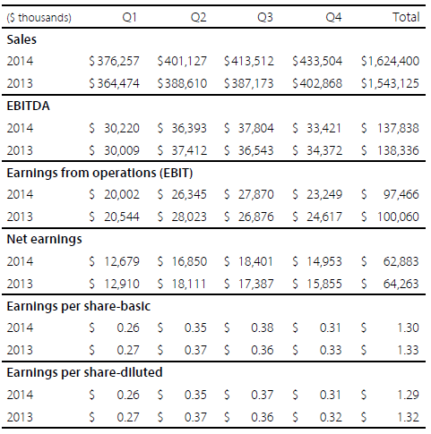
Seasonality
Historically, the Company's first quarter sales are the lowest and fourth quarter sales are the highest, reflecting consumer buying patterns
Due to the remote location of many of the Company's stores, weather conditions are often more extreme compared to other retailers and can affect sales in any quarter
Fourth quarter consolidated sales increased 7.6% driven by strong sales gains within the International Operations and the impact of forex on the translation of U.S. denominated sales
Net Earnings decreased 5.7% the impact of forex in international operations was more than offset by the general merchandise inventory reduction costs. Excluding this two, net earnings increased 8.7% YoY
Appendix Map I
Notes:
Net earnings decreased $0.9 million or 5.7% to $15.0 million and diluted earnings per share was $0.31 per share compared to $0.32 per share last year as higher net earnings in the International Operations and the impact of foreign exchange was more than offset by lower earnings in the Canadian Operations largely related to the general merchandise inventory reduction costs. Excluding the net impact of the general merchandise inventory reduction costs and foreign exchange, net earnings increased 8.7% compared to last year.

Slide 78
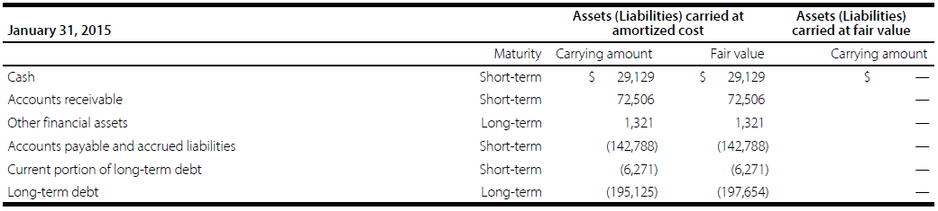
Hedging Activity
Credit Risk minimized through the company’s wide geographically diverse customer base; in addition, no customer accounts for greater than 10% of receivables
Currency Risk is hedged with US dollar denominated borrowings; 10% depreciation of the CAD against USD would cause net income to increase by $100k
Interest Rate Risk - Risk free Interest rate increase of 100 basis points will cause net income to decrease by $922,000; manages exposure to interest rate risk by monitoring its blend of fixed and floating interest rates, and may modify this blend using interest rate swaps (have done so in the past but have none currently)
Appendix Map I

Slide 79
Historical DPS and Dividend Yield
Appendix Map I
Notes:
The decrease in DPS and dividend yield from 2011 to 2012 was caused by the corporation changing to a share corporation which meant that they got taxed more heavily starting in 2011

Slide 80
Background Information about USANA
82% of sales are in markets outside of the United States
Operate in 19 markets worldwide
Products are sold via direct selling (no retail)
Customer Base comprises of “Associates” and “Preferred Customers”
Associates (349,000; 81%) act as independent distributors of USANA’s products any may purchase products for their own use
Preferred Customers (81,000) purchase the products strictly for personal use and are not permitted to resell or to distribute the products
New Strategies:
Simplified pricing structure – 10% price reduction on products and a bigger price discount on products ordered through the monthly Auto program
Increased payout to associates under the Compensation Plan resulting in higher compensation for new associates along with making it easier for associates to advance within the business
Launched a new marketing suite for Associates to gain access to tools and training online
Expanded sponsorship of “The Dr. Oz Show” to facilitate growth of the USANA brand within the United States
Increased growth in mature markets such as Canada, Australia, and New Zealand by cutting prices
New state-of-the-art facility in China will be operational during the first half of 2016 to capitalize on the growth opportunities available there
Appendix Map I

Slide 81

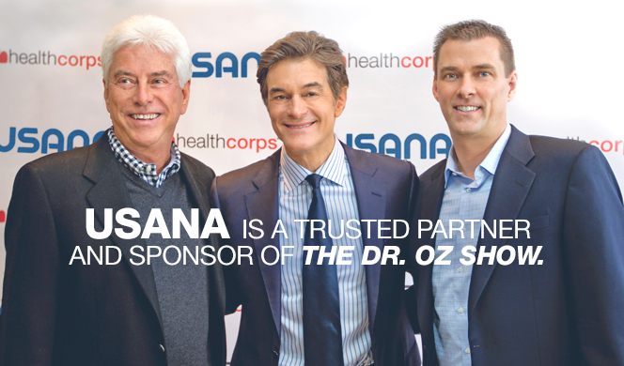
Background Information about USANA
Three manufacturing facilities: Salt Lake City, Beijing, Tianjin
In-House Manufacturing – 74% of product sales are produced in-house
Allows for better cost and quality control
New Facility in China
Dr. Oz Sponsorship
Appendix Map I

Slide 82
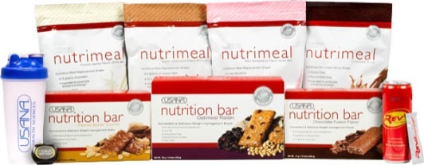

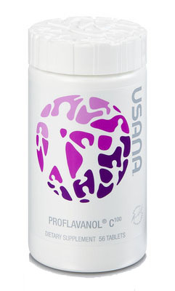
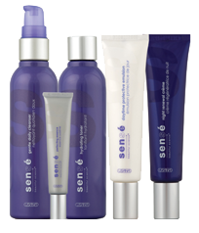
Product Mix Breakdown
Essentials – Vitamin and Mineral Supplements (Health Pak is $135 USD for 335 tablets)
Optimizers – To be used in conjunction with Essentials and these products support needs such as cardiovascular health, skeletal/structural health, digestive health
Foods – Meal replacement shakes, snack bars
Sensé Beautiful Science – Personal care products focused on supporting healthy skin and hair
Appendix Map I

Slide 83

U.S Regulatory Issues Facing Supplements Industry
Dietary Safety Labelling Act – Proposed in 2015, the law would give the Food and Drug Administration (FDA) to stop the sale of dangerous supplements and create a list of banned ingredients. Interest groups have opposed this act including senators who have been lobbied by supplement giants so the passage of the Act is highly unlikely.
Crackdown by Attorney General’s – 13 AG’s have launched investigations into the quality of supplements sold in the U.S. Many supplement products contained dangerous compounds not listed on the label and 1/3rd of them did not even contain the herb which was advertised.
2015
Appendix Map I

Slide 84


Net Sales by Region
North Asia = Japan
Most of the growth is fuelled by Greater China and the Southeast Asia Pacific region
Appendix Map I

Slide 85

USANA Commissions Salesperson Process
Salesperson is first invited to a conference where a USANA rep tells you about their product and how the company is not a pyramid scheme
Salesperson purchases a starter kit which costs around $30 and can sign up with the auto paying option which automatically deducts money every month from your account for the minimum product requirement. The salesperson has to buy at least $100 worth of supplements every 4 weeks in order to keep his license validated
Pyramid Scheme Element: If the salesperson cannot make the payments, then he/she can enlist his/her friends or family to sell on his/her behalf and the original salesperson would take a cut off the commissions made
The FTC shuts down a company immediately if it thinks the company is a pyramid scheme
To get around the pyramid scheme, USANA has the 5 customer rule where a representative has to make sales to 5 different people first before a commission can be received
“A pyramid scheme is an unsustainable business model that involves promising participant’s payment or services, primarily for enrolling other people into the scheme, rather than supplying any real investment or sale of products or services to the public.”
Appendix Map I

Slide 86
Structure of Network Marketing Program
Under the policies and procedures, Associates may not, among other things:
(i) use deceptive or unlawful practices to sell USANA products;
(ii) make deceptive or unlawful claims or representations concerning USANA products or Compensation Plan; or
(iii) sell competitive products to other USANA Associates or solicit USANA Associates to participate in other network marketing opportunities
Once a person becomes an Associate, she or he may purchase products directly from USANA at wholesale prices for personal use and resale to customers
The associates may create their own “down-line” by sponsoring new associates from which they can receive commissions from when the products are sold
There is also an annual renewal fee involved
Besides associates, around 20% of USANA’s customers are preferred customers which means they only purchase the products without having a distributor relationship with USANA
Associates receive little training; tools, resources, and optional training is available
Appendix Map I
Notes:
Product returns are low and historically have been at around 0.8 to 0.9%
Associates can return their unused product within the first 30 days for a 100% refund
After the 30 days, associates can return the product for up to 1 year at 100% of the purchase price less a 10% restocking fee

Slide 87

Some Facts about Associates and Court Case
67% of associates do not make any commissions
87% of commission-earning USANA associates do not make enough money to recover their monthly qualifying costs of buying products from the company
72% of all USANA commissions are earned by 8% of commission-earning associates
Most associates, however, as not interested in commissions but are instead just happy to get their monthly qualifying purchase for their own use
SEC came away empty handed on their investigation of USANA in 2007 regarding the validity of claims involving their multi-level marketing structure being a pyramid scheme
Barry Minkow
Former fraudster turned into self-proclaimed fraud investor
Filed 500 page report to SEC complaining about USANA’s illegal pyramid scheme
Appendix Map I
Notes:
Barry Minkow became a self-proclaimed fraud investor after going to jail for fraudulent activities himself
He sent a 500 page report to the SEC claiming that USANA was running an illegal pyramid scheme structural business

Slide 88

Compensation Plan for Associates
Commissions – To be eligible to earn commissions, Associates first have to sell a certain amount each month (qualifying sales). After this, they can earn commissions sold on products. They can also earn commissions on products sold by the associates they recruited. Paid weekly.
Bonuses – Based on pay-for-performance philosophy. Only given when the associate achieves the required performance measures.
Retail Mark-Ups - In markets where retail mark-ups are permitted, Associates purchase products from us at the Preferred Price and may resell them to consumers at higher retail prices
Contests and Promotions - Only paid upon the achievement of promotion objectives
Appendix Map I

Slide 89

USANA Product Potency
Appendix Map I

Slide 90



Sponsorships and Brand Awareness
Dr. Oz Show
U.S Ski Team
Women’s Tennis Association
Appendix Map I
Notes:
Luol Deng, NBA, player recently signed as well
It gives credibility to the company so it sends a signal to customers that they can trust the products because athletes are sponsoring them

Slide 91
Correlation of USNA with Competitors
Correlation of USANA with Competitors
Appendix Map I

Slide 92
Global Nutrition and Supplements Market
Aging population in the developed markets such as U.S, Japan, and U.K are more likely to be at risk of being diagnosed with chronic diseases
Business practices, ingredients, and products are often tailored to the regulatory environment in a particular region i.e. If an ingredient is banned in the U.S, suppliers will sell it in emerging economies like Brazil or India with their lax regulations
Consumers are more willing to spend money on nutrition and supplements
Since 2014, Canada requires products labeled as being “supplements” or “natural products” to be registered mandatorily
68% of U.S adults use dietary supplements; 50% of these are regular users
83% of U.S adults expressed overall confidence in the quality, effectiveness, and safety of dietary supplements
Asia-Pacific is the largest market for dietary supplements globally
Increase in disposable income allows customers to spend more on healthy food items
CAGR expected to be 9.1% from until 2020
Consumer awareness about the benefits of dietary supplements and wide product availability are the major drivers for the market in the region
Appendix Map I

Slide 93



Aging Populations
U.S.A
Note: USANA does not get involved in derivative securities ie. They do not actively hedge against risks
Appendix Map I

Slide 94


China and India’s Increase in Disposable Income
Global Market Share for Dietary Products
Appendix Map I

Slide 95
Market Projections by Persistent Market Research
The global sports supplements market will exhibit a CAGR of 9.1% between 2014 and 2020, by which year it will stand at US$12,449 million. The sports supplements market was worth US$6,800.8 million in 2013.
The global sports nutrition market is poised to reach US$37.7 billion by 2019, at a strong CAGR of 9% from 2013-19.
The global fatty acids supplements market will reach an estimated value of US$4,477.8 million by 2020. This market was worth US$ 1,912.0 million as of 2013, and will register a 13.1% CAGR from 2014 through 2020.
The global mineral supplements market projections show that it will rise to US$14.5 million in 2020 from US$7.3 million in 2013. This translates into a 7.3% CAGR from 2014 to 2020.
The global botanical supplements market is expected register a moderate CAGR of 7.5% from 2014 through 2020, rising to US$90.2 million by 2020.
The global clinical nutrition market will experience steady growth at a modest CAGR of 4.1% from 2014 through 2020, by which year it will stand at US$48.6 billion.
Appendix Map I

Slide 96

Mead Johnson’s YoY Sales - Asia
Asia
Shift in consumer demand for imported products due to the Chinese Milk Scandals which reduced sales for local dairy products by 30-40% so MJN’s locally manufactured brands are suffering
Recent launch of a fully imported brand is performing well in China however
Baby food demand has increased by more than 10 fold in China within a decade
One-Child policy in China is ending which should fuel growth for infant formula products
“White Gold” rush in China where Australian companies are making exaggerated claims of baby formulas boosting infant brain development and health
Appendix Map I

Slide 97
Mead Johnson’s YoY Sales – Americas and Europe
Latin America
USD strengthening against the Mexican Peso has decreased sales substantially
Soft economic conditions in Argentina and Colombia hurt sales as well
North America and Europe
USD vs. CAD was unfavourable for the sales of the company
Improved market share positions also contributed to an increase in revenue numbers
Appendix Map I

Slide 98


Mead Johnson’s Sales by Product and CF Statement
$437m used to repurchase shares; $244m used for dividend payments; $322m credit line borrowings utilized
Appendix Map I

Slide 99

2015 Repurchase Authorization
On October 20, 2015, the Company’s board of directors approved a new share repurchase authorization of $1.5 billion of the Company’s common stock (the “2015 Repurchase Authorization”)
The Company expects to finance the share repurchases through the issuance of debt, which may include long- term notes
Shares will be repurchased from time to time in the open market or in privately negotiated transactions, including without limitation, the anticipated use of a $1.0 billion accelerated share repurchase program
The Company expects to enter into a $1.0 billion accelerated share repurchase agreement (the “ASR Agreement”) in the short- term with an investment bank
Under the ASR Agreement, approximately 11 million shares will be received by the Company once the ASR Agreement is executed

Slide 100
Repurchase Plan’s Affect on Credit Rating
"The decision to intentionally leverage the balance sheet through share repurchases is an unfavourable shift in financial policy that weakens Mead's credit profile; however, there is sufficient cushion in the Baa1 rating to withstand the higher leverage, supported by the company's high cash balances, low starting leverage, and strong free cash flow," commented Brian Weddington, a Moody's Senior Credit Officer.
Debt/EBITDA rose to about 2.9x from 1.9x and net debt/EBITDA, net of approximately $1.4 billion of cash, increased to around 1.6x from 0.7x
The Baa1 long-term debt rating of Mead Johnson Nutrition Co. reflects the company's strong credit metrics, including operating profit margin in excess of 20%, retained cash flow to net/debt over 25%, and annual free cash flow over $300 million. The rating also is supported by the leading position of its "Enfa"-branded global paediatric nutrition franchise that generates a solid base of sales and earnings in the U.S. and has a strong and growing presence in emerging Asian and Latin American markets where over 70% of sales is generated. These strengths are balanced against key risk factors that include high category concentration in confidence-sensitive paediatric nutrition and high exposure to commodity input price and foreign currency volatility, especially in Asian and Latin American markets, that can cause price instability.
Appendix Map I

Slide 101


Inventories and Debt Breakdown
Five year revolving credit had interest rate of 1.3%; unsecured and repayable in June 2019; $750M is the max available amount; total debt to EBITDA cannot exceed more than 3.5:1.0 (currently at 2.9); EBITDA to total interest cannot be less than 3:1 (currently at 15:1); Used to repurchase shares
Appendix Map I

Slide 102


Hedging Activity
The Company uses foreign exchange contracts to hedge forecasted transactions, primarily foreign currency denominated inter- company purchases anticipated in the next 18 months and designates these derivative instruments as foreign currency cash flow hedges when appropriate
The forward starting swaps effectively mitigated the interest rate exposure associated with the Company’s offering of the 2044 Notes, the proceeds of which were used to redeem all of the Company’s 2014 Notes
The Company utilizes commodity hedges to minimize the variability in cash flows due to fluctuations in market prices of the Company’s non- fat dry milk purchases for North America
The following hedges are recorded at fair value

Slide 103

Mead Johnson’s Manufacturing Facilities
With more than 70 products in over 50 markets worldwide, Mead Johnson manufactures products for infants, children and adults all over the world
Appendix Map I

Slide 104

2008 Chinese Milk Scandal
2008 Chinese Milk Scandal which killed 6 babies and infected 300,000 more with melamine (used to manufacture plastic) which caused severe kidney problems such as kidney stones
The controls tests used to test for protein levels fails to distinguish between nitrogen in melanin and naturally occurring nitrogen in amino acids
Just four years prior to this, 13 infants had died from malnutrition due to watered-down milk
Aftermath:
11 countries stopped importing dairy products from China
Two people got executed by the Chinese government (Dairy farmer + manager of a milk production center)
Appendix Map I

Slide 105
Historical DPS and Dividend Yield
Appendix Map I
Notes:
The decrease in DPS and dividend yield from 2011 to 2012 was caused by the corporation changing to a share corporation which meant that they got taxed more heavily starting in 2011

